Slide 1
Opening Day
August 16, 2013

Slide 2
New Employees
Karen Kellingsworth
Richard Lopez
Heather Chittendon
Colleen Maloney-Hinds
Ben Gamboa
Lorena Guadiana
Donna Hoffmann
Bryan Reece

Slide 3
Other Changes
Joe Cabrales is Interim at Valley
Farewell to OE2
  Fire Academy Move
Rebeccah and Laura in LRC
Mentoring Program starting up again

Slide 4


$6,000 for mini-grants
  Up to $1,500 each
  Proposal Form
  5 Ipads
  Committee Review

Slide 5
Latino Americans Screening
PBS Series
CHC will host a public screening on September 23
Panel Discussion afterwards
Educational Resources can be found on the web
Hispanic Heritage Month Activities
  Features of CHC and Other Latino Individuals
  Activities

Slide 6
Fall Festival Family Event
Saturday, October 12
Inform and Inspire Families about College
Invitations to Yucaipa, Redlands, and Beaumont
Some sessions in English and Spanish

Slide 7
President’s Remarks
In Service Day
August 16, 2013

Slide 8
Key Points
My Rookie Season
Campus Culture
Student Success
Topics For Discussion

Slide 9
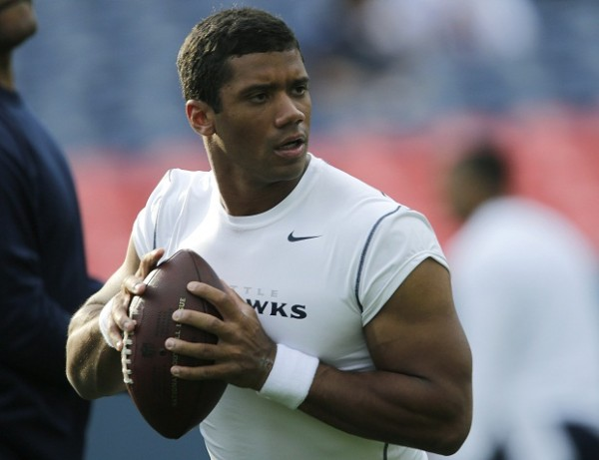
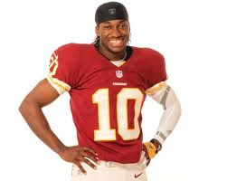
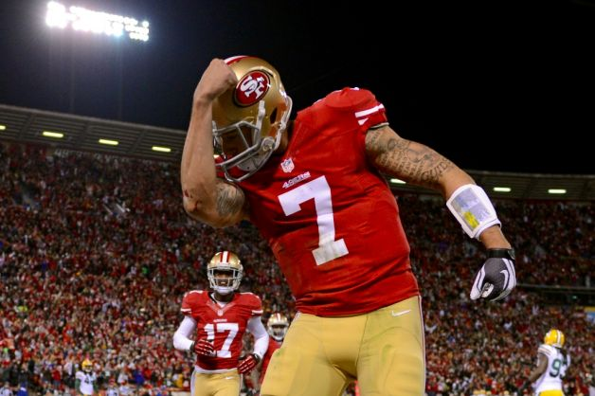
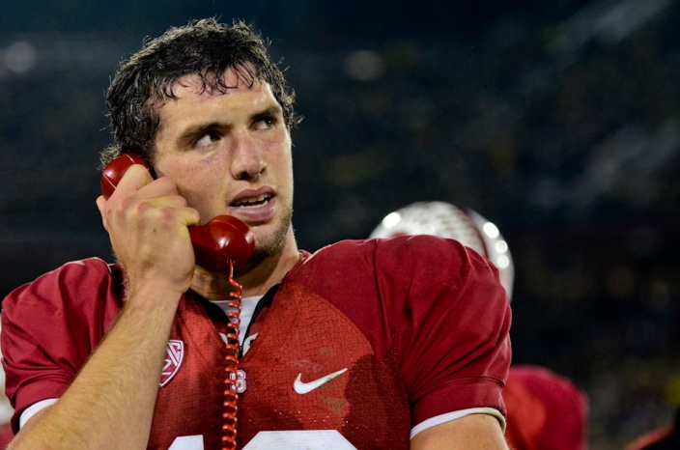
My Rookie Season

Slide 10
Enhance participative decision making allowing all voices to be expressed

Slide 11
Big Topics Discussed in 2012-2013
Construction Projects
Student Success Act & Initiatives
Enhancing Participation on Committees
EVP or VPI & VPSS
Growth for CHC
Improving Communication and Appreciation
New Program Approval Process
Role of the Budget Committee

Slide 12
Big Topics for Discussion in 2013-2014
Growth
Ed Master Plan
  Mission, Vision, Values
Student Success Act/Initiatives Implementation
Alignment & Partnerships
Accreditation
Construction
Communication
Online, Open Ed Resources, MOOCs

Slide 13
Build a culture that is
collaborative, innovative,
appreciative, fun,
and action-oriented
People Matter
Open Communication

Slide 14
Campus Culture
Committee Eval Results
Climate Survey
“The campus culture…has become much more positive and hopeful than it used to be, but the spirit of negativity, selfishness, and entitlement is still quite alive…What steps can/should we take to change this?”

Slide 15
Some Suggestions
Ask questions
Gain full information
If ambiguous, ask for clarification
Avoid assumptions
Consider if how you are saying something is disrespectful or hurtful
Focus on the problem not the person
Avoid assigning motives

Slide 16
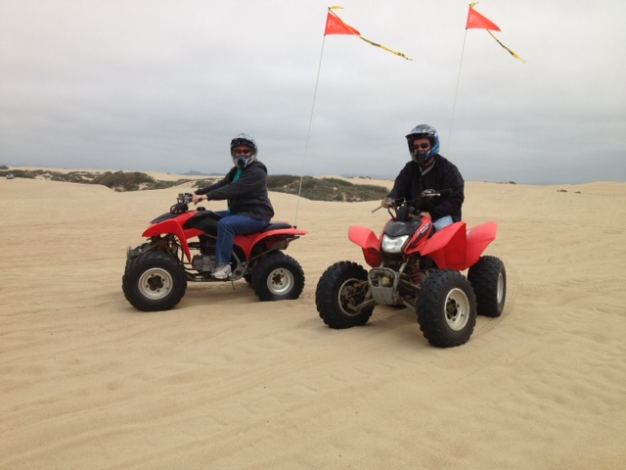
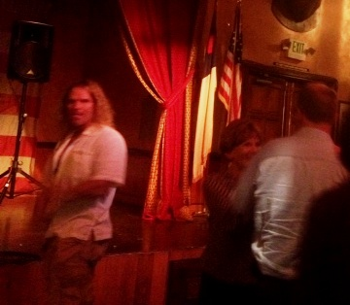
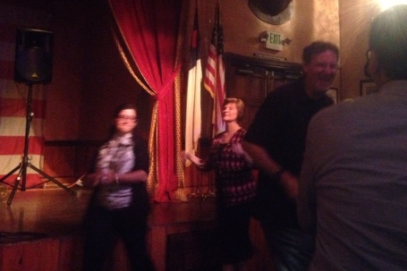
Have Some Fun

Slide 17
Build systems and processes to sustain and enhance student success and a quality learning environment
As a campus, embody our values: creativity, inclusiveness, excellence, and learning centeredness
We are “revolutionary” in our efforts to help students succeed

Slide 18
Lee Shulman & The Carnegie Foundation
How do we construct an educational world in which success is the constant?
Quality of instruction, social connection, the experience of success

Slide 19
Five Year Target
CHC Community
Students
Inspire
Engage
Enlighten
Learn
Empower
Advance

Slide 20
Inspire, Enlighten, Empower
Exposure
Alignment
Service
Early Alert
Acceleration
Assessment
Ed Plans
SI & Tutoring
Open Entry
Orientation
Cohorts
Web Modules
Boot Camps
Honors
Co-Curricular
Transfer
Technology
85% of students achieve their goals

Slide 21
Doing Stuff
Keep up the good work!
Experiment
Measure
Tolerate mistakes
Mistakes are the portals of discovery.
– James Joyce

Slide 22
Last Year’s Proposal
We focus on students
  Everyone has a part in their educational experience
We become a community of scholars
  Learners, experts in our roles
  Interconnected
  Share information

Slide 23

Planning for Growth
State Budget Increase
  “Whom Shall We Serve?”
  Rebuild and Redirect
District Allocation Model
  70/30 Split: Round 2
  District Budget Committee

Slide 24
Accreditation
CCSF
Our status

Slide 25
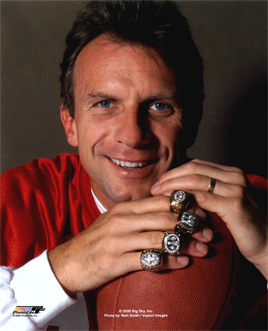
My Rookie Season
Looking at the whole college
Make the tough decisions
Operational challenges and quagmires
Stifle fear
Be a facilitator
Seek out information and input
Share the big picture
Keep growing

Slide 26
Closing Thoughts
Education is not filling a pail but the lighting of a fire. ~ William Butler Yeats
Education is the ability to listen to almost anything without losing your temper or your self-confidence. ~ Robert Frost
Let's make a dent in the universe.
~ Steve Jobs

